Slide 1
Example-Based Object Detection in Images by Components
Kadır mert özcan - 1780512

Slide 2
Index
Summary of the Paper
Our method
Creating the vectors
Training the cascade
Test Results

Slide 3
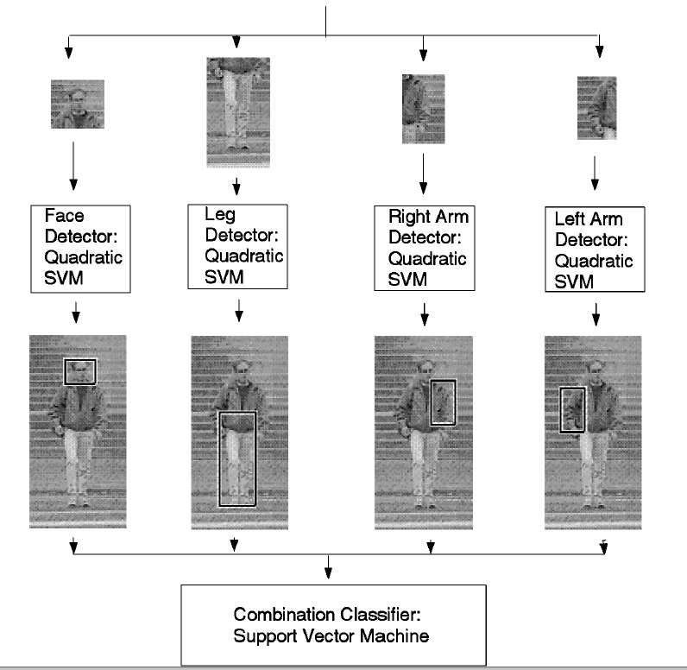
Summary of the paper
4 Components: Head, left & right arms, legs
Components are detected over 128x65 pixel windows using quadric SVM classifiers.
Components are detected over fixed locations in the windows.

Slide 4
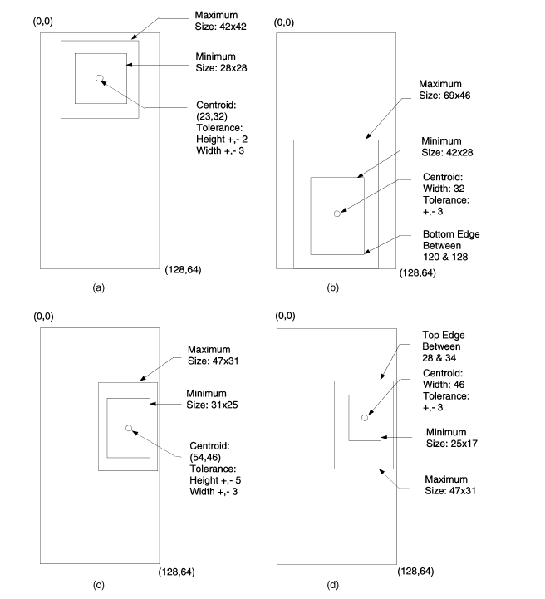
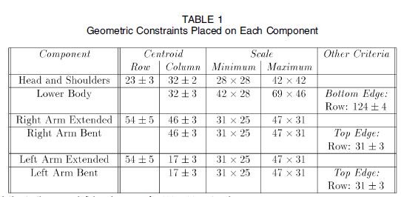

Slide 5
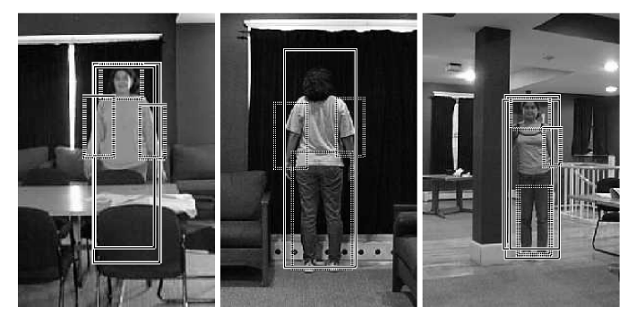

Slide 6
Issues ın theır approach
SVM is outdated
Only detects people who are facing their faces or their backs to the camera.
Geometric constraints are fixed to the window. Cannot detect people who aren’t standing up.
Better approach would be making the component locations relative to each other.

Slide 7
Our Approach:
Download a set of negative images from flickr with python script.
Handpick relevant parts of the positive images to create the Haar vector file.
Train the Haar Cascade Classifier using the vector and the negative images.
Detect the components in an image with OpenCV’s detectMultiScale function.
Decide whether the desired object is found or not.

Slide 8
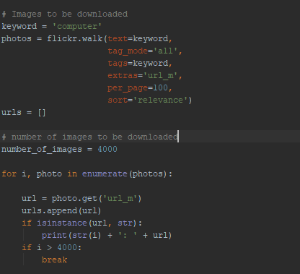
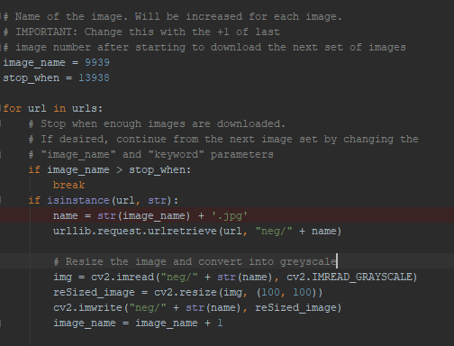
Downloadıng the ımages

Slide 9
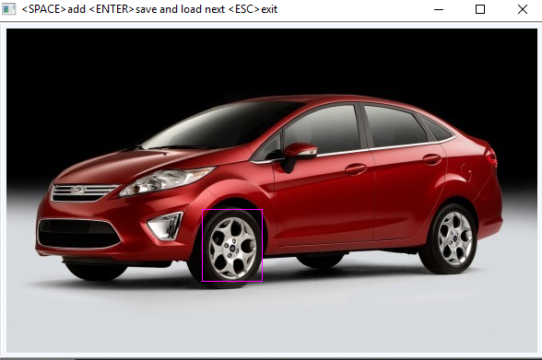
Pıckıng the components
Since we don’t have a classifiers for car component, we need to create our own vectors.
Components are hand picked using a program called ObjectMaker.

Slide 10
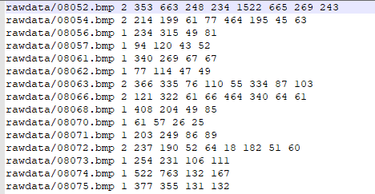
Pıckıng components (cont.)
A txt file is created as a result with the:
Image path
Number of components selected
Coordinates of X axis
Coordinates of Y axis
Image lenght
Image width

Slide 11
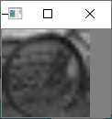
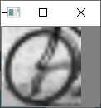
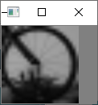
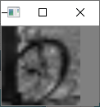
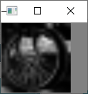
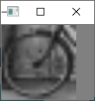
Why both Qualıty and qualıty of vectors are ımportant?
First try: Bicycle front wheel is selected as our first component
1251 images to pick the components
~700 wheels picked as a result

Slide 12
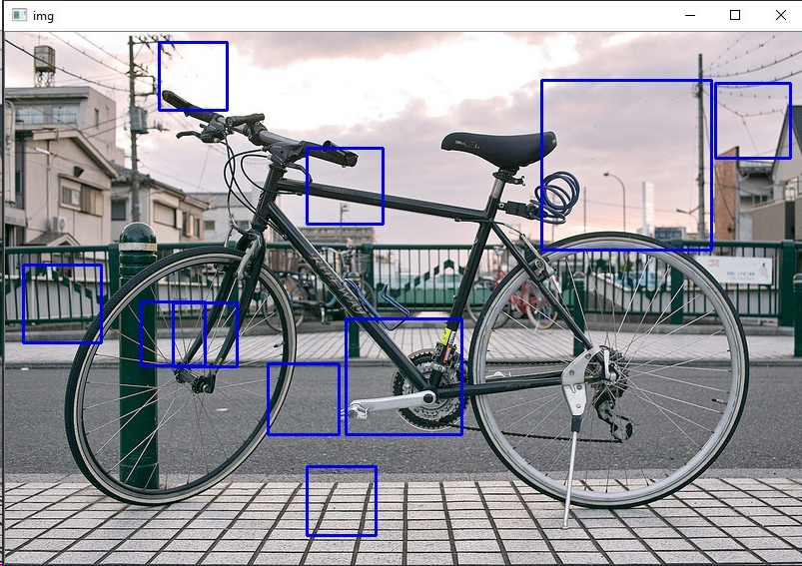
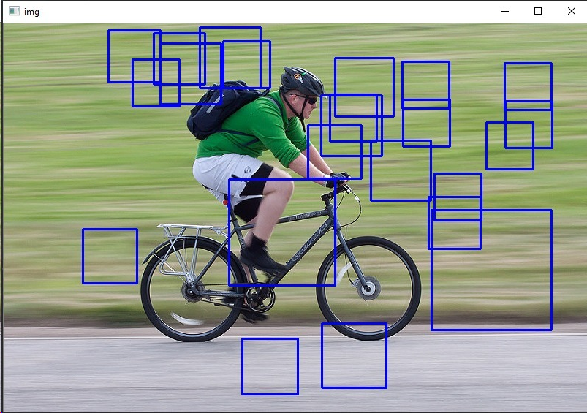
Result of the fırst trıal: dısaster!

Slide 13
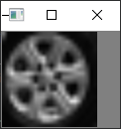
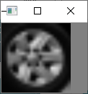
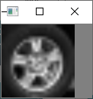
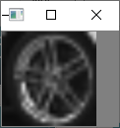
Why?
Not enough number of positive samples are given to the training algorithm
Bicycle wheel has too much background noise
Solution:
Changed the object to be detected to car.
A car is much more «solid» than a bicycle: not much background.
Increased the number of images a lot: 8143 images in total.

Slide 14
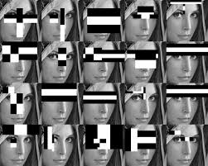
Traınıng the classıfıer
Algorithm extracts over 160000 image out of each image
Finds the best threshold for each feature to mark it as a negative or a positive.
Features with minimum error rate have their weight increased.
Final classifier is the weighted sum of weak classifiers.

Slide 15
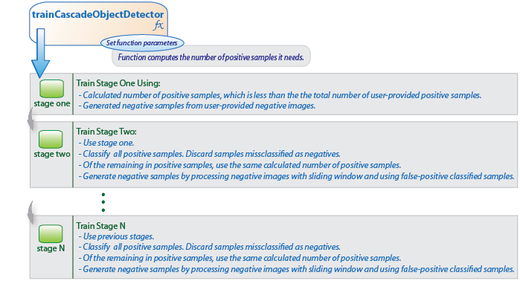

Slide 16
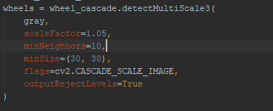
Detectıng the components
scaleFactor: Parameter specifying how much the image size is reduced at each image scale.
minNeighbors: Parameter specifying how many neighbors each candidate rectangle should have to retain it.
minSize: Ignore objects that are smaller than this.
outputRejectLevels: Adds weight values to the outputs

Slide 17
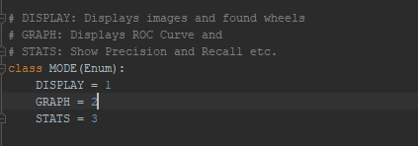
3 DIFFERENT MODES
DISPLAY:
Iterates through images and shows them on the screen.
GRAPH:
Sets the threshold to 0, iterates through images and displays ROC-Curve and FAR-FRR Graph
STATS:
Iterates through images and calculates TP, TN, FP, FN, Precision, Recall, Accuracy and F1-Score

Slide 18
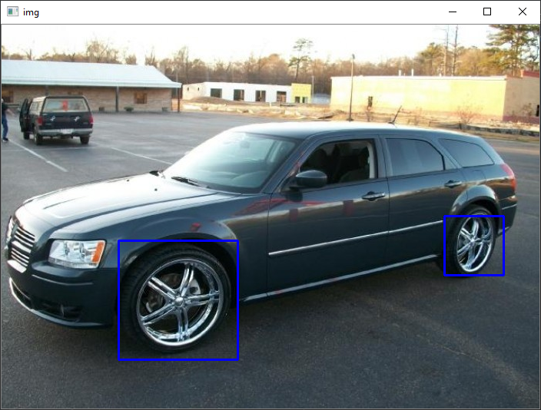
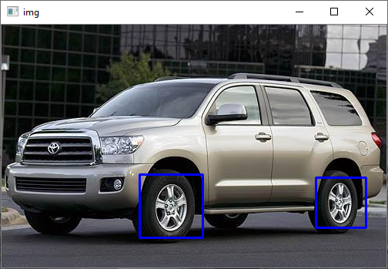
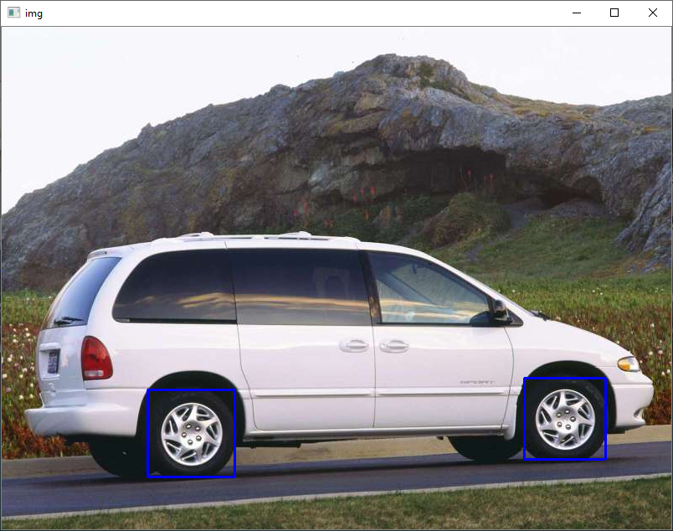
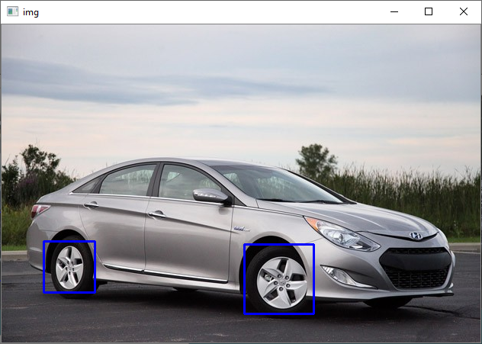
dISPLAY MODE

Slide 19
Graph mode
2 Sets: 100 Positive Images, 100 Negative Images
Weights range from 0 to 5.8. They are normalized to display in the graph.
False Positive rate is extremely low. Because of the way OpenCV algorithm works, weight = 0 is returned when no wheel is detected.
This results in interesting graphs...

Slide 20
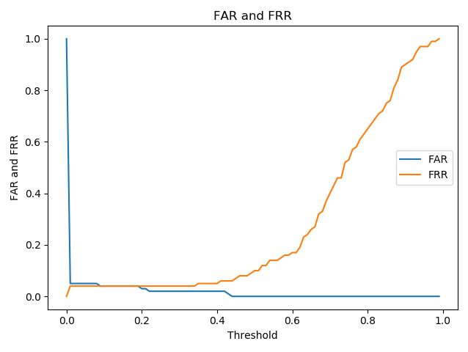
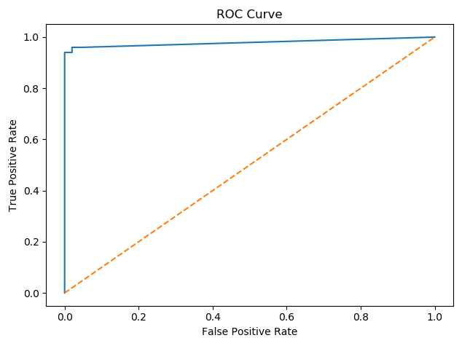
GRAPH MODE

Slide 21
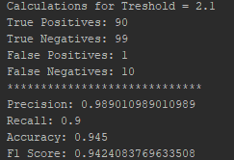
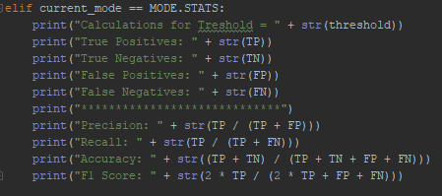
Stats mode

Slide 22
THANK YOU
Questions?

